Slide 1
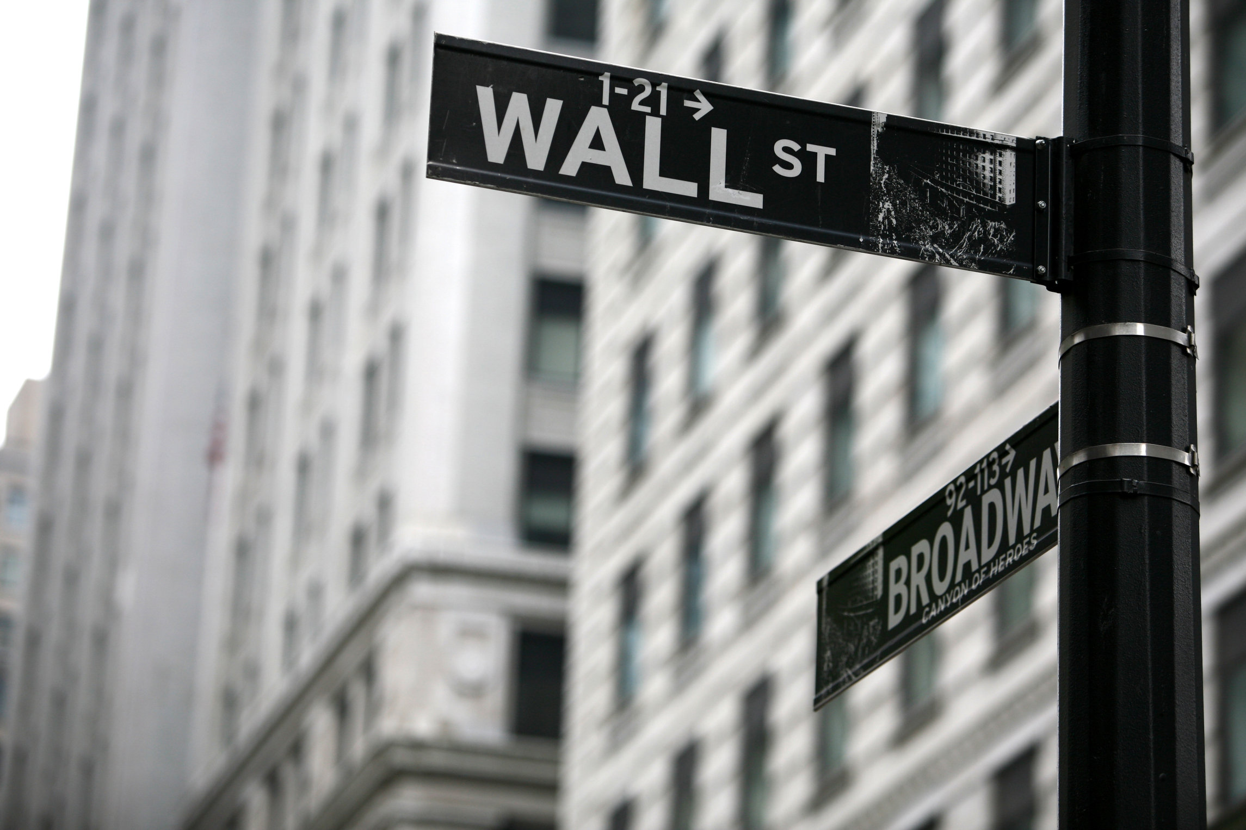
Stock Group

Slide 2
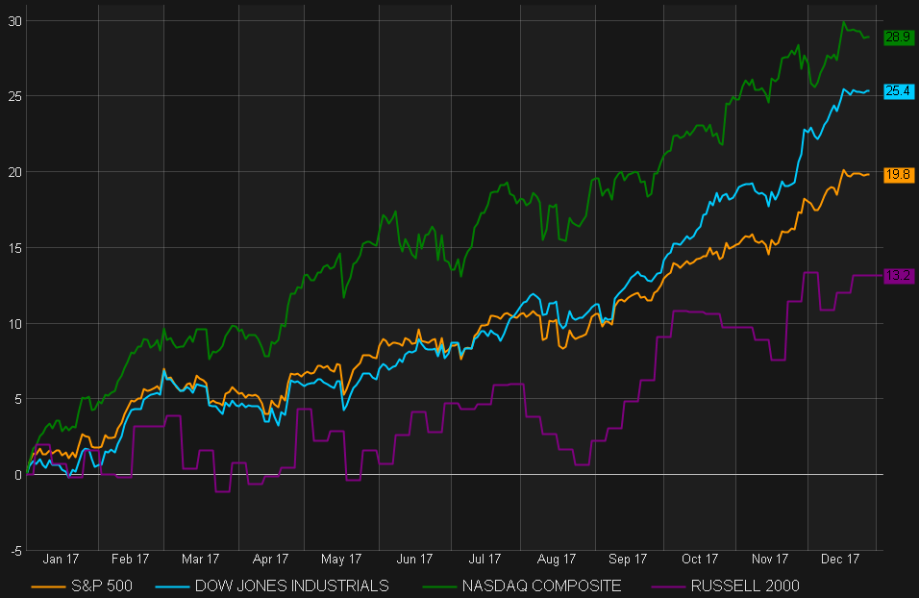
US INDEXES
Notes:
שוק המניות – אלה תשואות המדדים בשנת 2017
בחרנו לנתח את מדד ה-s&p500 , 500 המניות הכי גדולות בארה״ב, עשה באזור ה-20 אחוז תשואה שנתית (נחשב חריג לטובה)

Slide 3
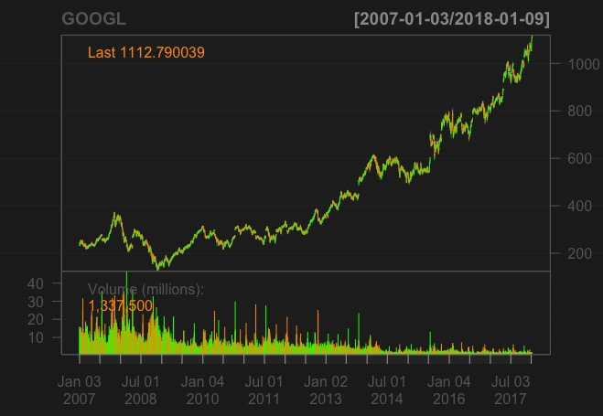
Notes:
הנה לפניכם הגרף של מניית גוגל, כולכם מכירים, המניה עלתה בסביבות ה-500% ב-10 שנים האחרונות
ומה שאנחנו ננסה לעשות בדקות הקרובות זה לחזות האם המחיר של מניית גוגל יעלה או ירד בסיום יום המסחר היום בבורסה בארה״ב?

Slide 4
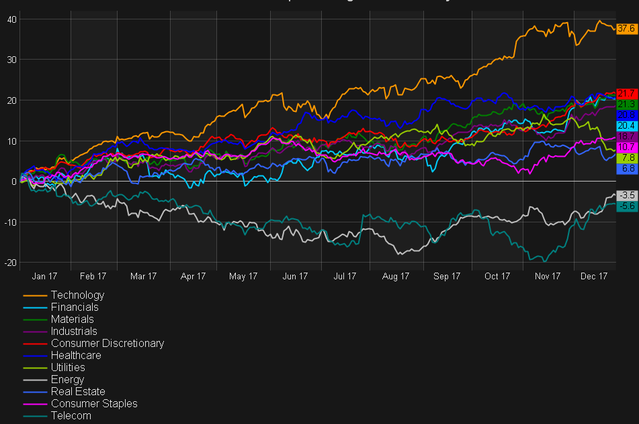
S&P 500 INDEX
Notes:
המדד מורכב ממניות מהרבה מאוד סקטורים- טכנולוגיה, פיננסים, תעשיה, אנרגיה, גנריקה,נדל״ן, תקשורת וכו׳...

Slide 5
Business Goals
Predict if Tomorrow’s stock price will be raised
Predict if the stock price over 10 days will be raised
Predict if the stock price over 30 days will be raised

Slide 6
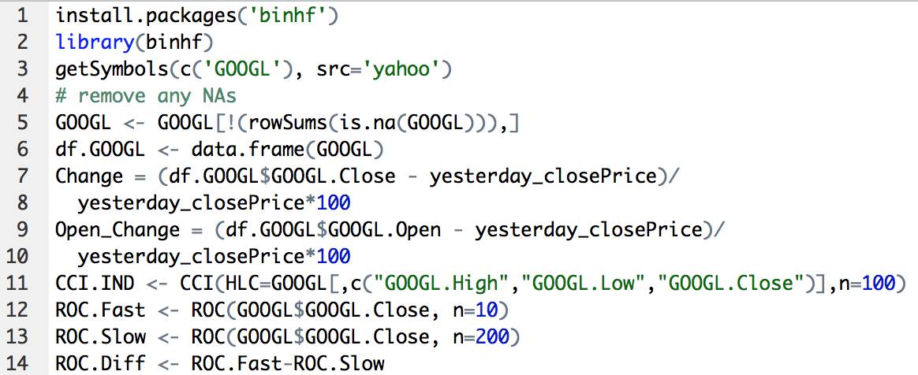
Data Description
Variable Name | Description | Type | Possible values
Date | Trading Date (format- dd/mm/YY) | Date | 25/11/2015
Symbol | The name of the company | String | "AAPL"
Open | The open price at this trading date | Numeric | Positive, USD
High | The highest price reached in this trading date | Numeric | Positive, USD
Low | The lowest price reached in this trading date | Numeric | Positive, USD
Close | The close price at this trading date | Numeric | Positive, USD
Volume | The number of total shares that are traded on a given day | Numeric | Positive, USD
Change | The percent number of change in the price relative to the previous day price | Numeric | Positive/ Negative percent
Open Change | The percent number of change in the previous day close price relative to the open day price | Numeric | Positive/ Negative percent
Change within | The percent number of change in the open day price relative to the close day price | Numeric | Positive/ Negative percent
nextday_open_change | The percent number of change in the close price relative to the next open day price | Numeric | Positive/ Negative percent
nextday_close_change | The percent number of change in the close price relative to the close next day price | Numeric | Positive/ Negative percent
Market Cup | Total equity market value | Numeric | Positive, USD
RSI | The relative strength index (RSI) is a momentum indicator that compares the magnitude of recent gains and losses over a specified trading date to measure speed and change of price movements of a security | Numeric | Positive/ Negative percent
EMA | Indicator in technical analysis that helps smooth out price action by filtering out the “noise” from random price fluctuations. The two basic and commonly used MAs are the simple moving average (SMA), which is the simple average of a security over a defined number of time periods, and the exponential moving average (EMA), which gives bigger weight to more recent prices | Numeric | Positive, USD
S&P 500 close | The close price of S&P 500 index at this trading date | Numeric | Positive, USD
order | The right order in every day depending on the price of tomorrow | factor | "buy","sell","hold"
High_close | True if high price equal to close price | logical | "0", "1"
Data from Yahoo Finance
10 years of each stock from S&P500
Data Frame of 60 variables over 2800 rows
We added some Technical indicators such as:
EMA, ROC, RSI, CCI etc.
Notes:
לעדכן את הקוד בוק
לקשר את הקוד בוק
לעשות צילום מסך לקוד
לעדכן את הטבלה של המשתנים לפי הטבלה של הקוד בוק

Slide 7
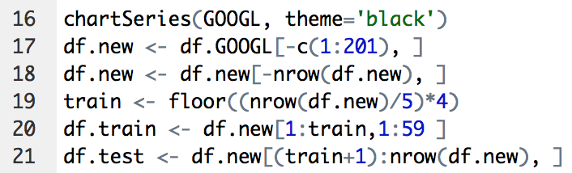
Data Preparation
Train
Test
Notes:
הכנת הדאטא – חלוקה לאימונים ומבחן

Slide 8

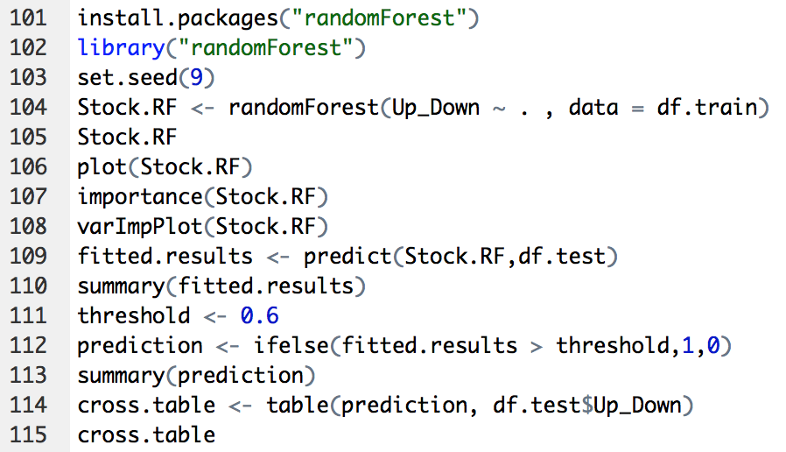
Classification
Predict if Tomorrow’s stock price will be raised
Y is a categorical variable when:
“Down” = 0 , “Up” = 1
Classification by RF and GBM models
Threshold = 0.6

Slide 9

GBM
RF

Slide 10
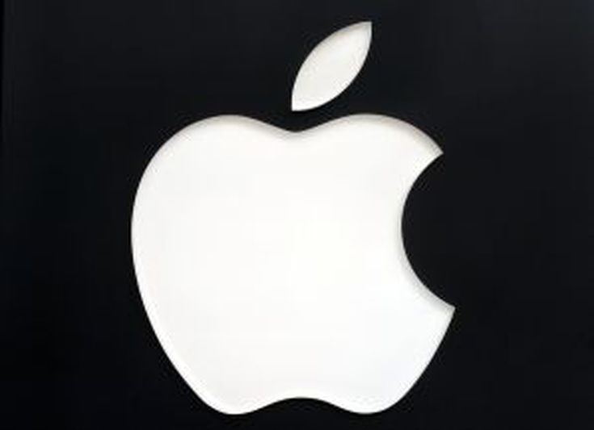
Confusion Matrix
Classification
Predicted Value | Reference (True Value in Test) |  | GBM
 | 0 ”Down” | 1 “Up” | Total
0 ”Down” | 194 | 190 | 384
1 “Up” | 71 | 101 | 172
Total | 265 | 291 | 556
Predicted Value | Reference (True Value in Test) |  | RF
 | 0 ”Down” | 1 “Up” | Total
0 ”Down” | 252 | 269 | 521
1 “Up” | 13 | 22 | 35
Total | 265 | 291 | 556
GBM
RF
Accuracy = 0.53
Precision = 0.58
Recall = 0.34
Accuracy = 0.49
Precision = 0.63
Recall = 0.07

Slide 11
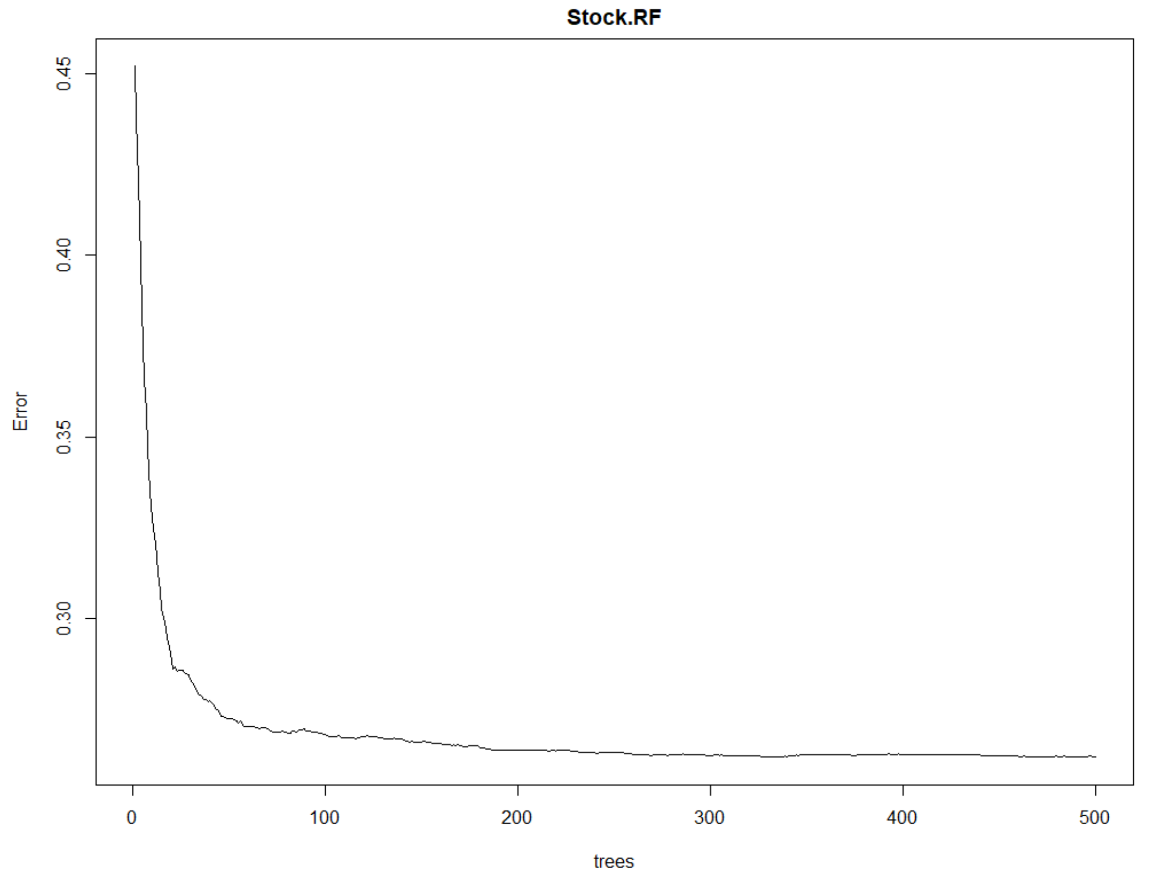
Error Tree

Slide 12
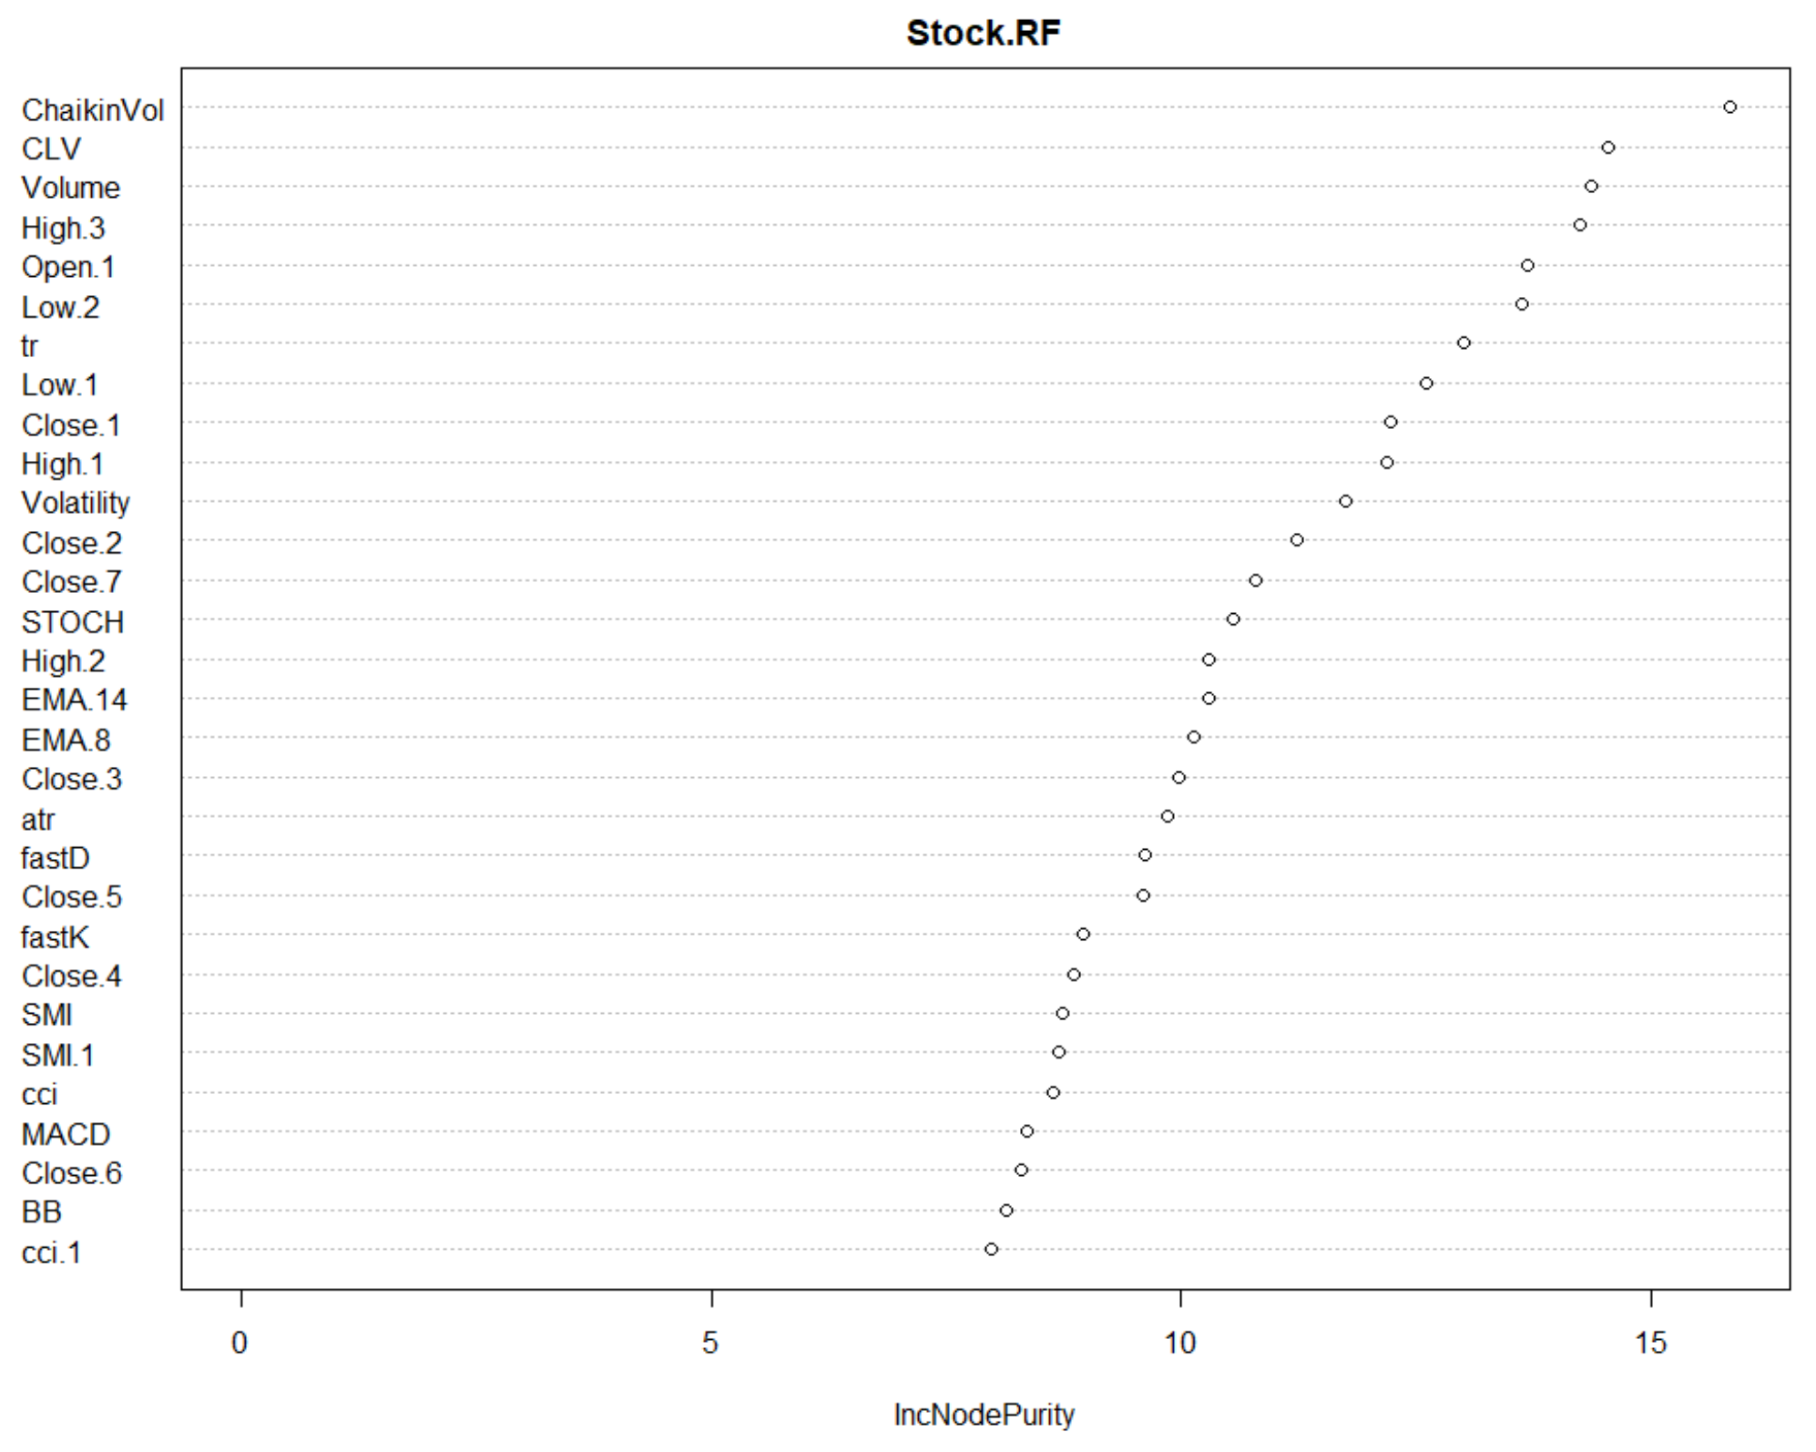
RF Interpretability

Slide 13
Predict the stock price Tomorrow
Predicted Stock | Confusion Matrix RF Model
 | Accuracy | Precision | Recall
GOOGL | 0.49 | 0.72 | 0.08
AAPL | 0.49 | 0.63 | 0.07
XOM | 0.49 | 0.59 | 0.07
INTC | 0.47 | 0.61 | 0.11
CAH | 0.49 | 0.51 | 0.08
GBM
RF

Slide 14

Confusion Matrix
Classification
Predicted Value | Reference (True Value in Test) |  | GBM
 | 0 ”Down” | 1 “Up” | Total
0 ”Down” | 172 | 173 | 345
1 “Up” | 86 | 125 | 211
Total | 258 | 298 | 556
Predicted Value | Reference (True Value in Test) |  | RF
 | 0 ”Down” | 1 “Up” | Total
0 ”Down” | 248 | 272 | 520
1 “Up” | 10 | 26 | 36
Total | 258 | 298 | 556
GBM
RF
Accuracy = 0.53
Precision = 0.59
Recall = 0.42
Accuracy = 0.49
Precision = 0.72
Recall = 0.08

Slide 15
R markdown

Slide 16
Predict the stock price over 30 days
Predicted Stock | Confusion Matrix GBM Model
 | Accuracy | Precision | Recall
APPL | ? | ? | ?
GOOGL | ? | ? | ?
GE | ? | ? | ?
??? | ? | ? | ?
??? | ? | ? | ?
GBM
RF

Slide 17
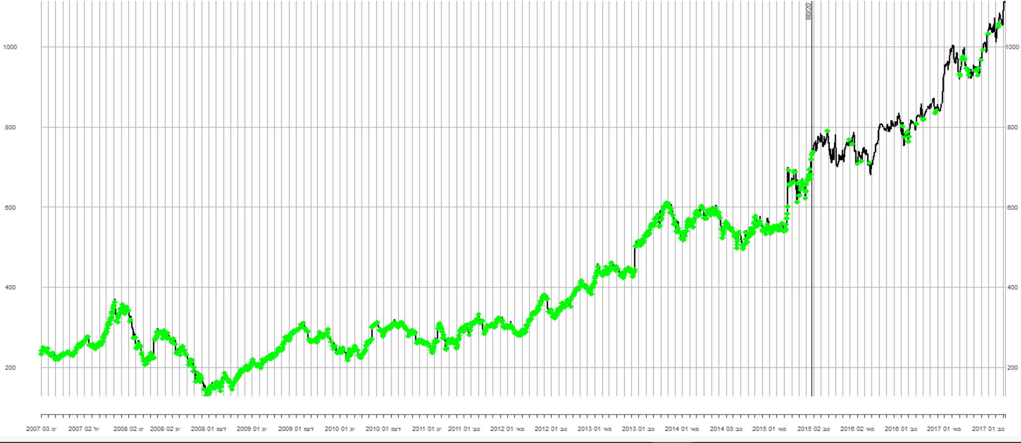
Test Results
Train
Test
Notes:
הכנת הדאטא – חלוקה לאימונים ומבחן

Slide 18
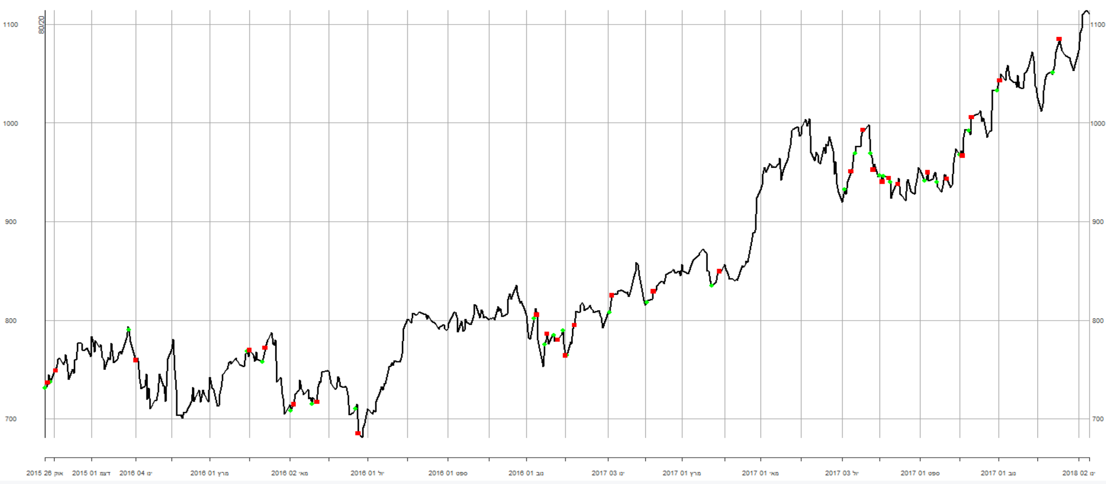
Test Results
Notes:
הכנת הדאטא – חלוקה לאימונים ומבחן

Slide 19
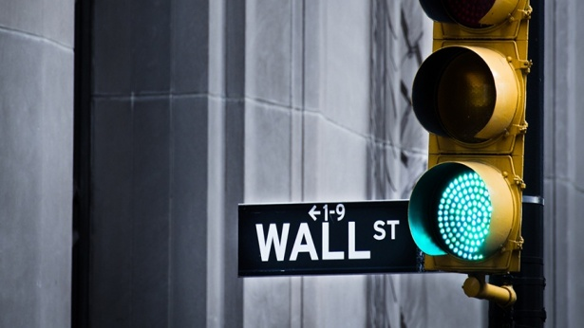
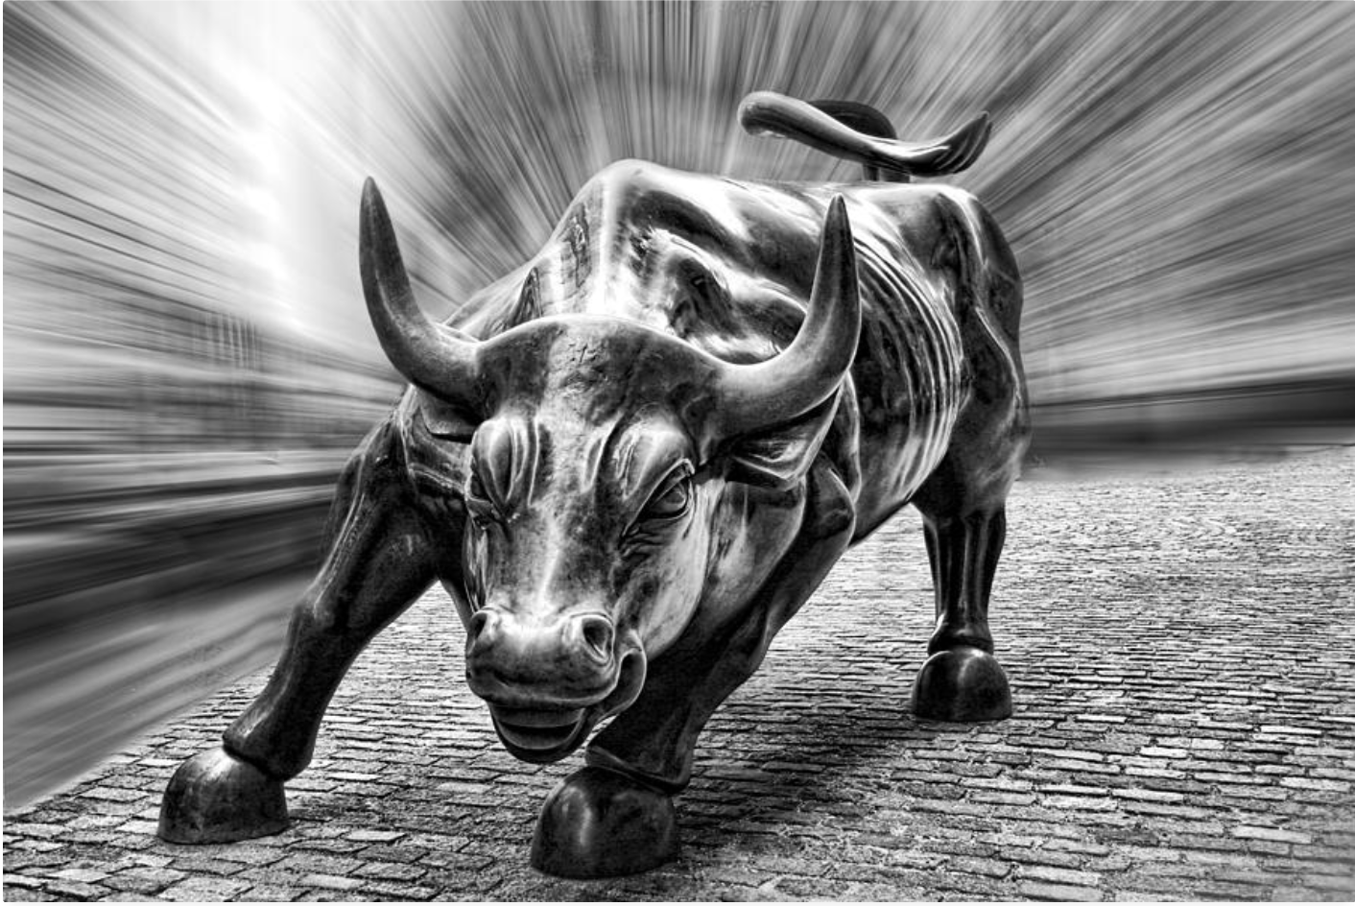
Add a Slide Title - 4
GOOGLE STOCK PREDICT
TODAY

Slide 20
Add a Slide Title - 4

Slide 21
Title and Content Layout with Chart

Slide 22
Grade for Regression (10 min, 20% of course grade)
Placing a clear target of the regression (10%)
Data preparation before the regression (10%)
Technical capabilities in the regression (20%)
Using R-Markdown (or Jupyter)
Using the R functions from the regression class exercise
Using multi variant regression
Evaluating several regression models (10%)
Interesting observations found (40%)
Showing the value of findings
Clear presentation
Innovation and creativity (10%)

